Slide 1
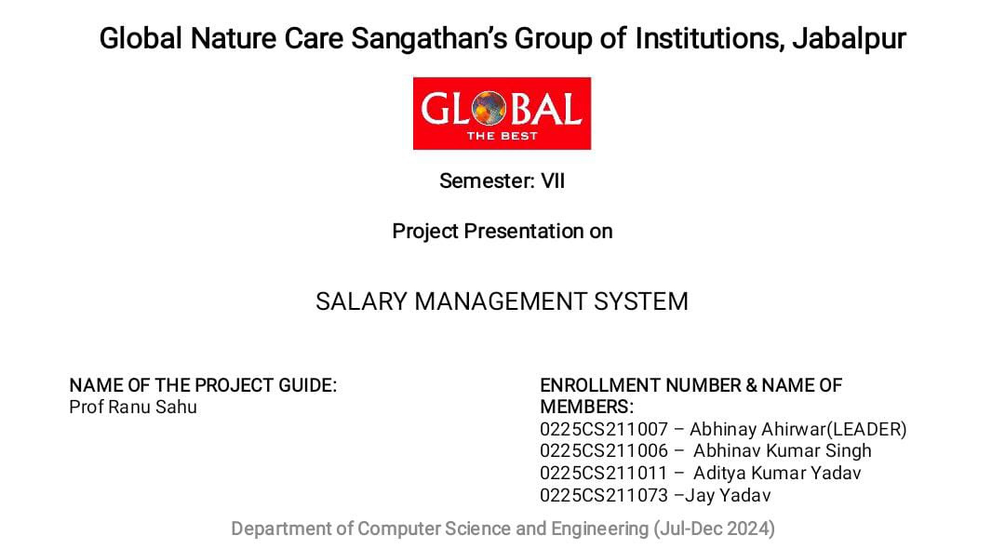

Slide 2

CSE 7th Sem Major Project
SALARY MANAGEMENT SYSTEM

Slide 3
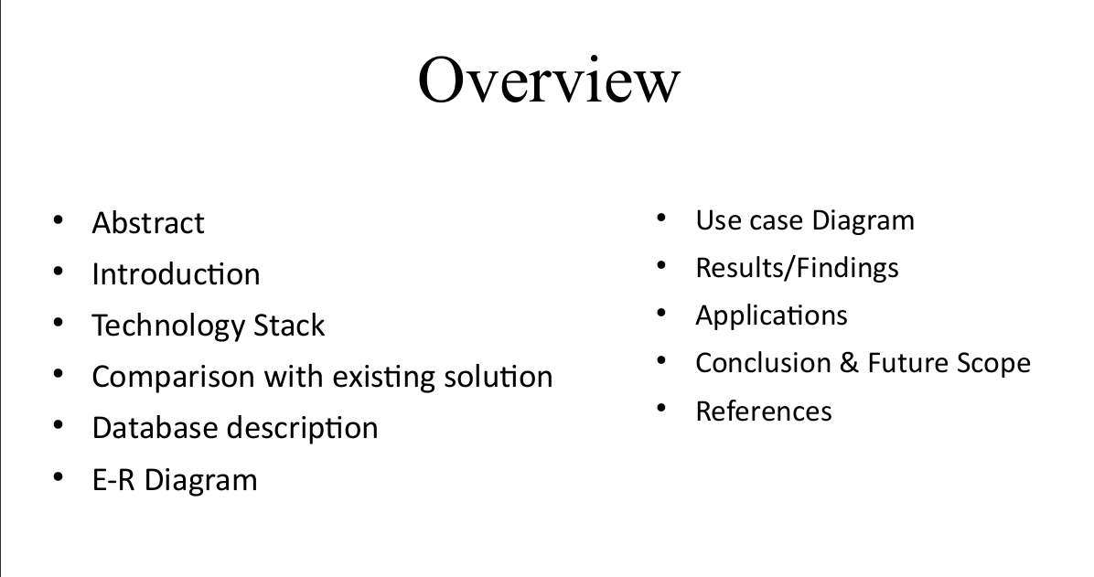

Slide 4

ABSTRACT
"The 'Employees Salary Management System' is a software project designed to streamline salary management for organizations. This system automates tasks like salary calculation, deductions, bonuses, and payslip generation, ensuring accuracy and efficiency in payroll operations."

Slide 5
INTRODUCTION
"This project aims to simplify the process of managing employees' salaries in an organization. By automating payroll operations, this system reduces human errors, saves time, and enhances data accuracy. With a user-friendly interface, the application allows HR personnel to manage salary components, tax deductions, and bonuses, ensuring timely salary processing."
"Organizations require reliable payroll management to handle employee remuneration efficiently, which led to the creation of this project."

Slide 6
TECHNOLOGY STACK
Front-end Technologies
Back-end Technologies
Database
HTML: Structures the content and layout of the web application.
CSS: Styles the interface for a clean, user-friendly experience.
JavaScript: Adds interactivity, making the app responsive and dynamic.
ReactJS: A JavaScript library used for building the user interface, ensuring smooth, fast performance and easy component management.
Tailwind CSS: Used tailwind for designing attractive UI Interface
Node.js: A JavaScript runtime that allows us to build a scalable, high-performance server.
Express.js: A Node.js framework used to simplify the setup of the back-end server and API routes.
MySQL: A relational database management system that stores data in structured tables, making it easy to manage complex employee and payroll data with secure and efficient queries.

Slide 7
COMPARISION WITH EXISTING SOLUTIONS
EXISTING SYSTEM
OUR SYSTEM
1.Existing systems may require manual input, leading to errors.
2.Many solutions lack flexibility to fit unique needs.
3.Some software is complex and requires training.
4.Commercial payroll software can be expensive.
5.Updates in some systems are delayed so lacks Real-Time Processing.
1.Fully automated for efficient and accurate salary management
2.Allows custom salary structures, deductions, and bonuses.
3.Simple and intuitive, reducing training time.
4.Budget-friendly, open-source, and effective.
5.Instant updates with real-time processing.

Slide 8
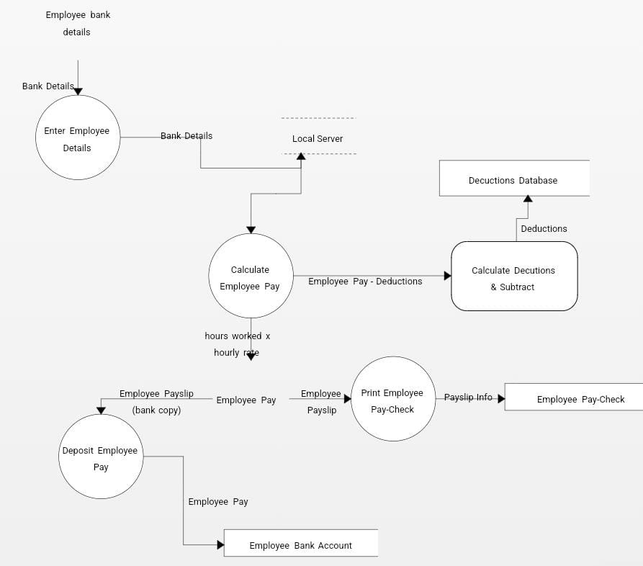
DATA FLOW DIAGRAM

Slide 9
DATABASE DESCRIPTION
Employee Table
Salary Table
Attendence Table
Payroll Table
Purpose: Stores essential employee information.
Fields: EmployeeID, Name, Position, Department, Contact Information, Date of Joining.
Purpose: Manages salary components and calculations.
Fields: EmployeeID, Basic Salary, Allowances, Deductions, Bonuses, Net Salary.
Purpose: Tracks employee attendance records.
Fields: EmployeeID, Date, Status (e.g., Present, Absent, On Leave).
Purpose: Manages salary disbursement and payment status.
Fields: EmployeeID, Month, Salary Paid, Payment Date, Payment Status.

Slide 10
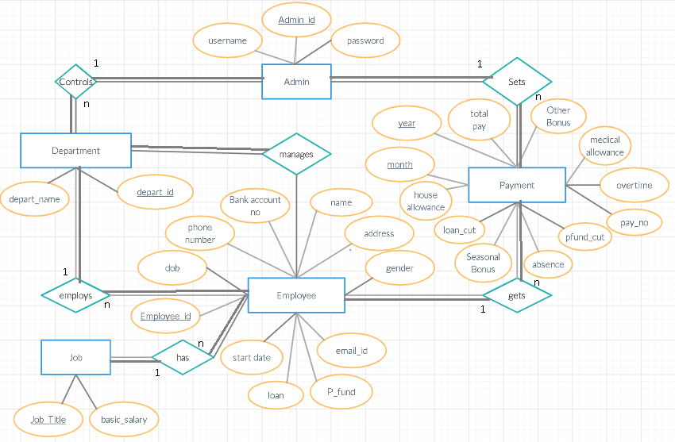
ENTITY RELATIONSHIP-DIAGRAM

Slide 11
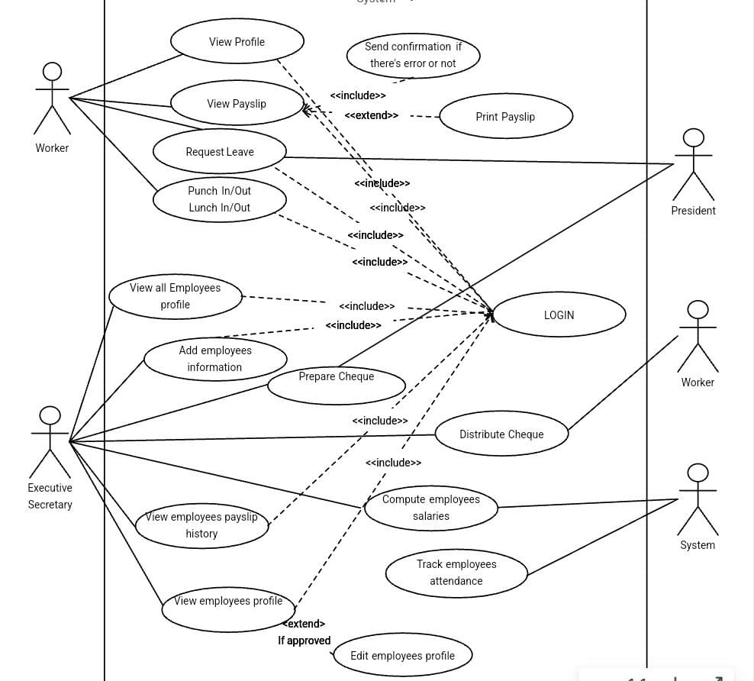
USE-CASE
DIAGRAM

Slide 12
Applications
Payroll AutomationSpeeds up salary processing, reducing errors and manual work.
Attendance and Leave TrackingAccurately tracks attendance for seamless payroll integration.
Small to Medium Business SolutionAffordable and user-friendly, ideal for smaller organizations.
Customizable Salary StructuresAdapts to unique pay structures, deductions, and bonuses.
Real-Time ReportsProvides payroll insights to support financial planning.Summary: Our system is a flexible and efficient payroll solution for various organizational nee

Slide 13
CONCLUSION
FUTURE SCOPE
“Our Employees Salary Management System successfully streamlines payroll operations, automating tasks like salary calculation, attendance tracking, and payslip generation. By reducing human error and saving time, the system improves accuracy and efficiency for HR departments, particularly in small to medium-sized organizations.”
Multi-Language Support
Expand accessibility by adding support for multiple languages, making the system more user-friendly for diverse workplaces.
Mobile Application
Develop a mobile app version for on-the-go access, allowing users to manage payroll tasks from any device.
Integration with Tax and Compliance Systems
Integrate with local tax and compliance regulations to automatically calculate deductions, making the system adaptable across different regions.
Advanced Data Analytics
Incorporate analytics to provide insights on payroll trends, helping organizations make informed financial decisions.

Slide 14
REFERENCES
1
Technical Documentation
MySQL Documentation:
https://dev.mysql.com/doc/
Node.js Documentation:
https://nodejs.org/en/docs/
Express.js Guide:
https://expressjs.com/
ReactJS Documentation:
https://reactjs.org/docs/
2
Research -
Payroll and HR resources: HR websites, like HR Technologist and SHRM(Society for Human Resource Management).
Diagrams : From Creately.com
Refrence from similar projects: Youtube (https://youtube.com/@webcode867?feature=shared) and GitHub.

Slide 15
CSE 7th sem Major Project
THANK YOU
for your time and attention
Presented by
Abhinay Ahirwar (0225CS211007)
Aditya Kumar Yadav (0225CS211011)
Jay Yadav (0225CS211073)
Abhinav Kumar Singh (0225CS211006)

